Slide 1
Stock Portfolio Optimization Using QAOA
CSCI 4973/6973
Levy Lin, Holden Mac Entee, Batuhan Yalcin, Oliver Adams

Slide 2
OUTLINE
Background
Current Implementation
Constructing Graphs
Alignment of Initial State and Mixer
Simulation Results
Hardware Results
Summary
Future Work
Questions?

Slide 3
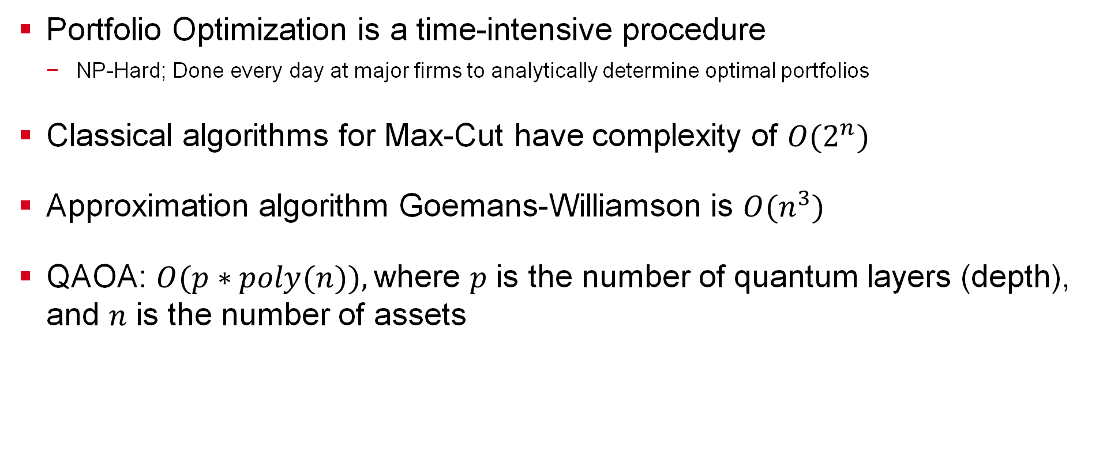
Background
Portfolio Optimization is a time-intensive procedure
NP-Hard; Done every day at major firms to analytically determine optimal portfolios
Classical algorithms for Max-Cut have complexity of $O(2^{n})$
Approximation algorithm Goemans-Williamson is $O(n^{3})$
QAOA: $O(p∗poly(n)),$where $p$ is the number of quantum layers (depth), and $n$ is the number of assets

Slide 4
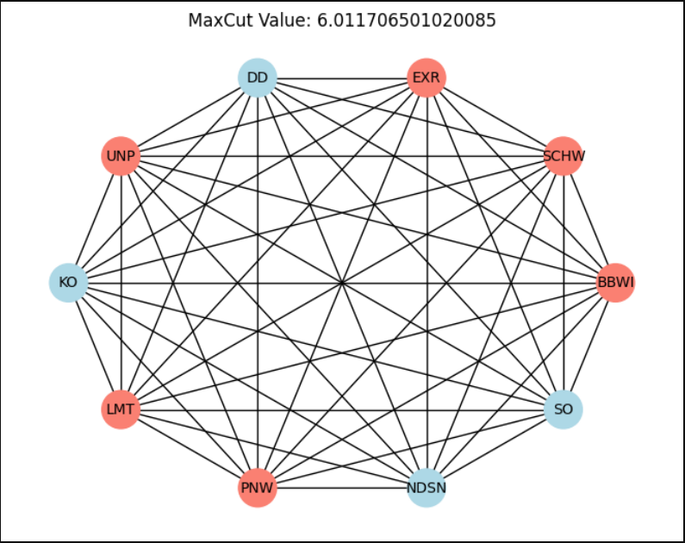
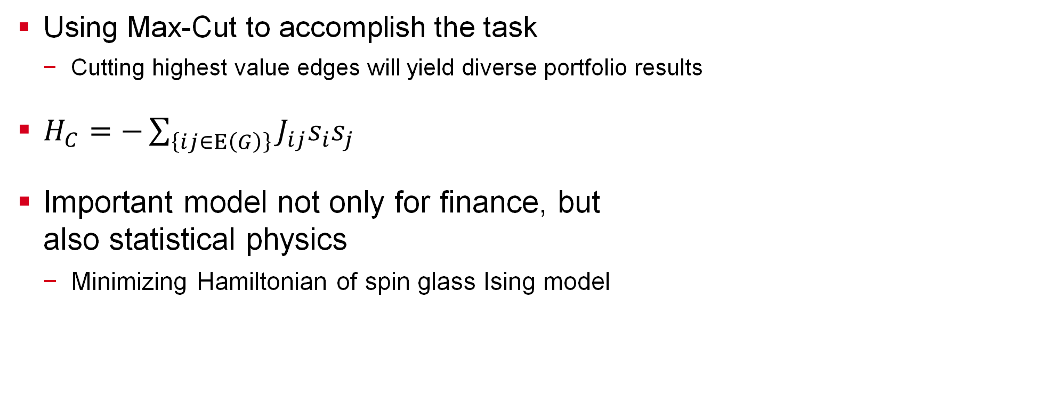
Graph Max-Cut
Using Max-Cut to accomplish the task
Cutting highest value edges will yield diverse portfolio results
$H_{C}=−\sum_{\left\{ij∈E\left(G\right)\right\}}{J_{ij}s_{i}s_{j}}$
Important model not only for finance, but also statistical physics
Minimizing Hamiltonian of spin glass Ising model

Slide 5
Current Implementation
We proposed 4 changes we wanted to make to our algorithm:
Pipelining the Current Implementation
Constraining Mixer
Implementing Parity Check
Alignment of Initial State and Mixer
Considered JPMorgan Chase & Co paper on error mitigation

Slide 6
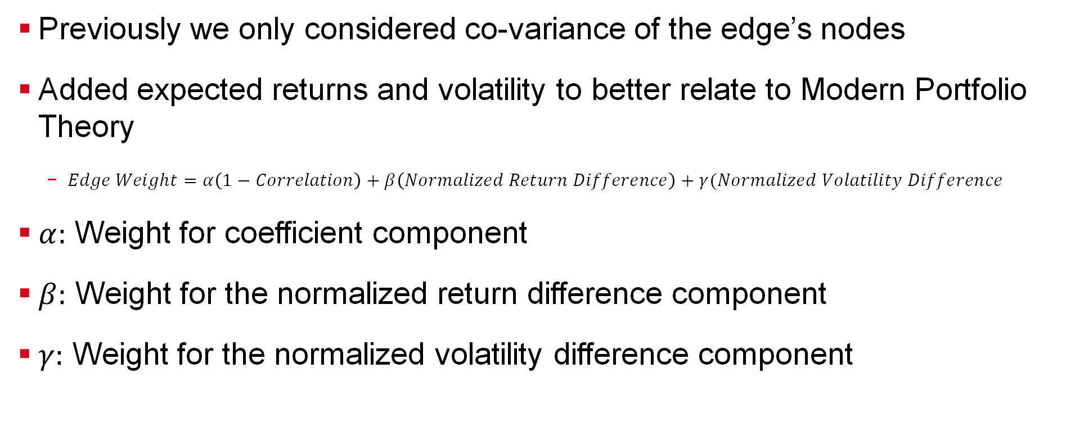
Constructing Asset Graphs
Previously we only considered co-variance of the edge’s nodes
Added expected returns and volatility to better relate to Modern Portfolio Theory
$Edge Weight=α\left(1−Correlation\right)+β\left(Normalized Return Difference\right)+γ(Normalized Volatility Difference$
$α:$ Weight for coefficient component
$β:$ Weight for the normalized return difference component
$γ:$ Weight for the normalized volatility difference component

Slide 7
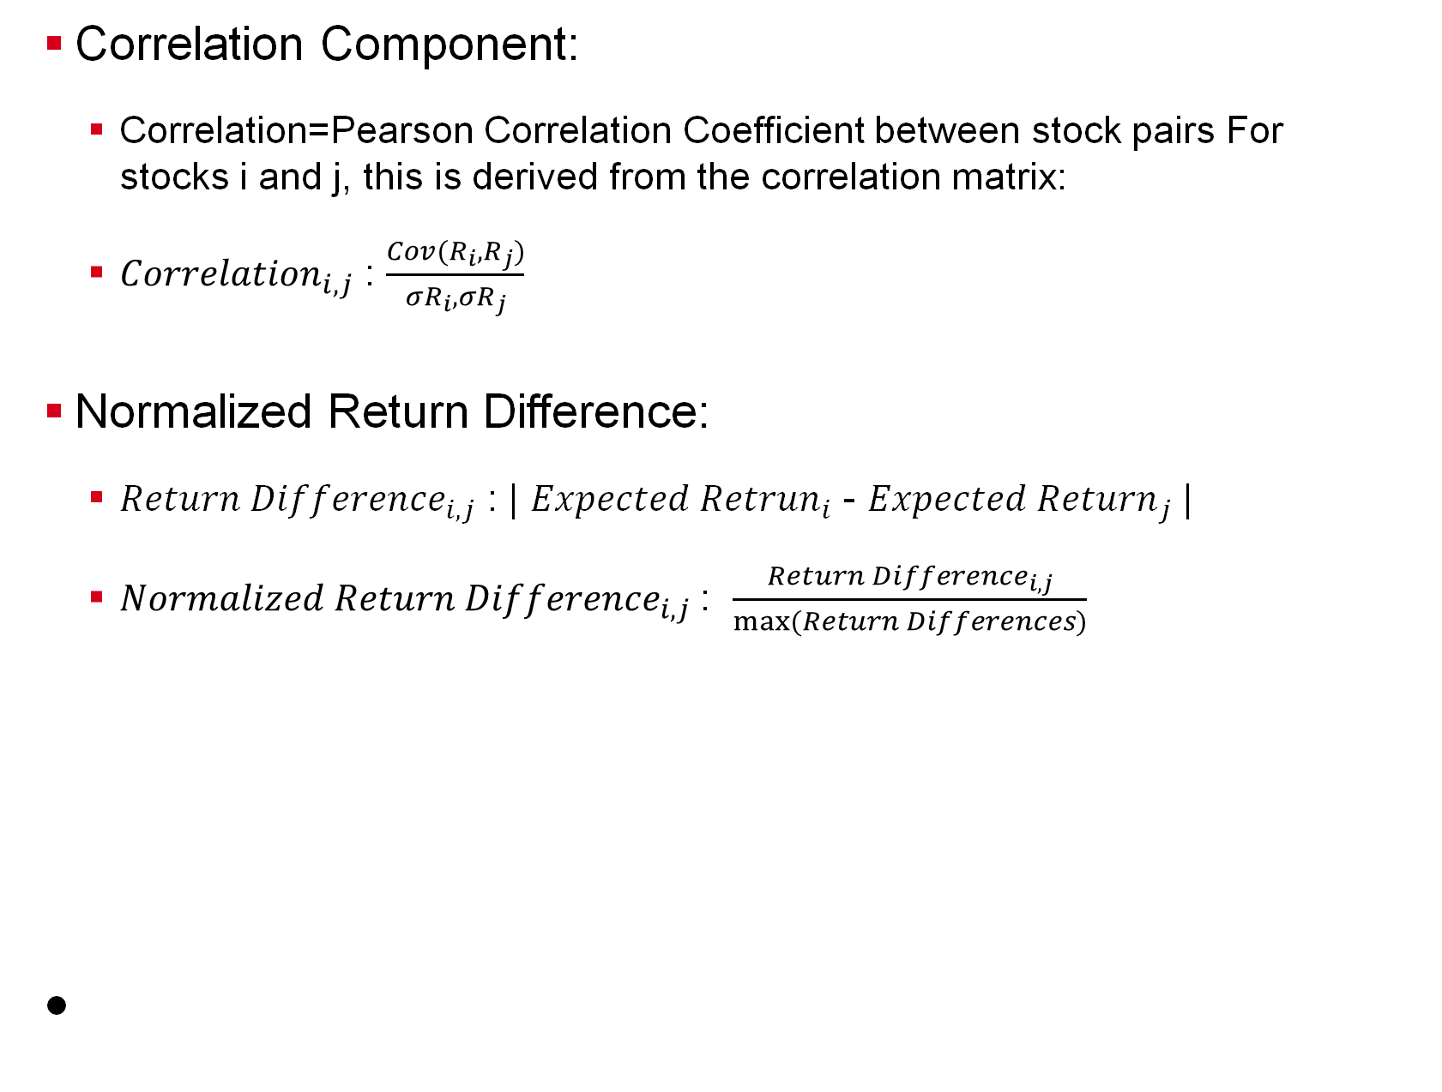
Constructing Asset Graphs
Correlation Component:
Correlation=Pearson Correlation Coefficient between stock pairs For stocks i and j, this is derived from the correlation matrix:
${Correlation}_{i,j}$ : $\frac{Cov(R_{i},R_{j})}{{σR}_{i},{σR}_{j}}$
Normalized Return Difference:
${Return Difference}_{i,j}$ : | ${Expected Retrun}_{i}$ - ${Expected Return}_{j}$ |
${Normalized Return Difference}_{i,j}$: $\frac{{Return Difference}_{i,j}}{max(Return Differences)}$

Slide 8
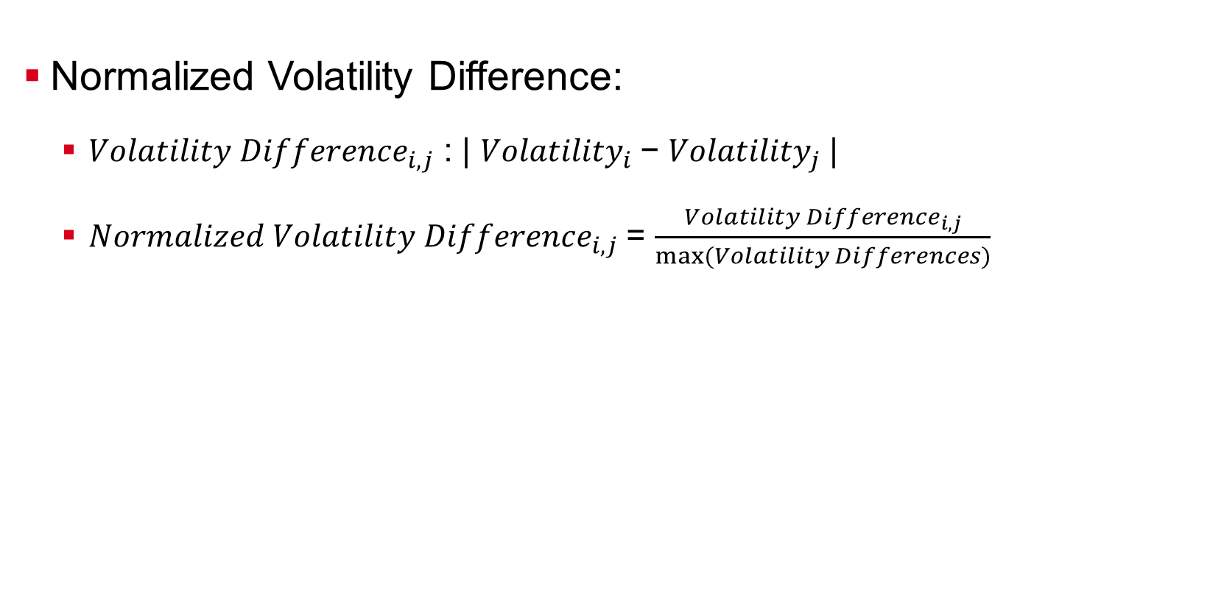
Constructing Asset Graphs
Normalized Volatility Difference:
${Volatility Difference}_{i,j}$ : | ${Volatility}_{i}$− ${Volatility}_{j}$|
${Normalized Volatility Difference}_{i,j}$= $\frac{{Volatility Difference}_{i,j}}{max⁡(Volatility Differences)}$

Slide 9
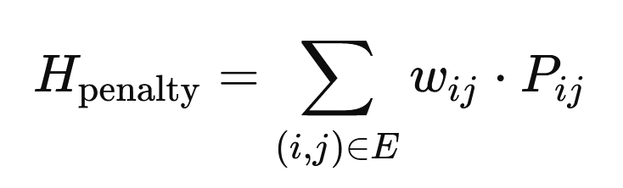
Constraining Mixer
Implemented a penalty Hamiltonian, combined with the Cost Hamiltonian
Penalty is derived from the graph’s edge weight and the penalty term (=1)
Keep the previous X-Mixer Hamiltonian

Slide 10
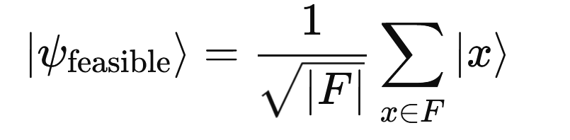
Alignment of Initial State and Mixer
With a Standard X-Mixer and Penalty Hamiltonian, we need to align the initial state
Can accomplish this in two ways:
Configure Initial state as a feasible solution, [01101]
Encode the initial state as [01101] using X-gates
Configure the Initial state as a superposition of multiple feasible solutions, [01101], [10010], …
Constructing an initialization gate using the Initialize function to encode the superposition of multiple feasible states

Slide 11
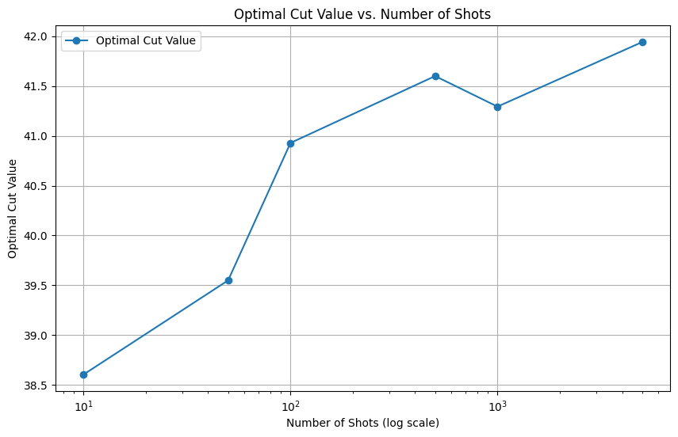
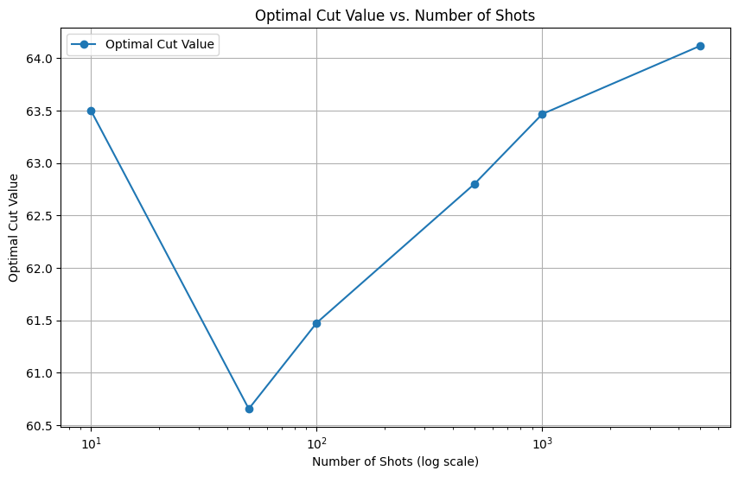
Simulation Results
Scaled up graph sizes: 5 nodes -> 25 nodes
Achieve high fidelity results on 20 and 25 node graphs
20 Node Graph
Metrics | Classical | Simulation
Cut-Value | 42.7541438 | 41.8677730
Bitstring | 00000001111110011110 | 11010110100001100001
25 Node Graph
Metrics | Classical | Simulation
Cut-Value | 66.6295369 | 64.1515339489
Bitstring | 0000100010111111001101110 | 1110101111000100010010001

Slide 12
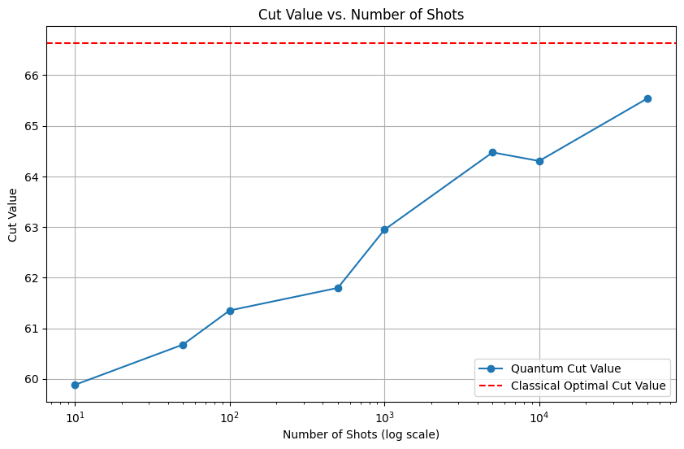
Hardware Results
Achieve high fidelity results on 25 node graphs and evaluated cut portfolios
25 Node Graph
Metrics | Classical | Classical Approx | Hardware
Cut-Value | 66.6295369 | 65.487498 | 65.9001713
Runtime | 3 hours | 1 minute | 30 minutes

Slide 13
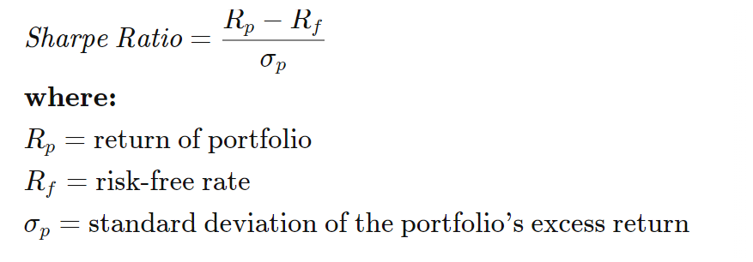
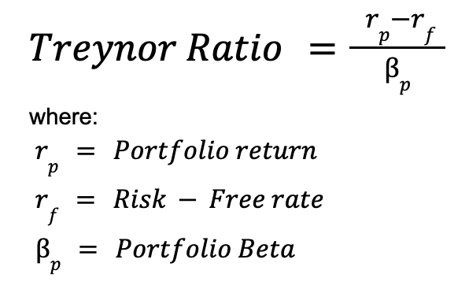
Hardware Results cont.
Higher is better; Assume equal portfolio weight per asset
Measures Reward / Volatility
20 Node Graph
Metrics | Pre-Max-Cut | Post-Max-Cut
Sharpe Ratio | 15.325935 | 19.7928495
Treynor Ratio | 0.035236 | 0.07619061
25 Node Graph
Metrics | Pre-Max-Cut | Post-Max-Cut
Sharpe Ratio | 16.58032 | 30.58404
Treynor Ratio | 0.041822 | 0.060761

Slide 14
Summary
Achieved high fidelity on larger graphs that were previously unacceptable
Implemented a more robust version of MPT
Constrained mixer to better guide towards correct answer
Incorporated parity check to eliminate erroneous data
Aligned mixer to initial state for better solution search

Slide 15
Future Work
Error Mitigation as proposed by JPMorgan Chase & Co
Improvements to Penalty Hamiltonian to Penalty Mixer
Searching for possible speed up
More Scalability of graph instance size

